Slide 1
Modeling Swine Flu Transmissibility
Alyssa Espiritu, Michael Grodus, Emily Martinez, Madeline Sankaran

Slide 2
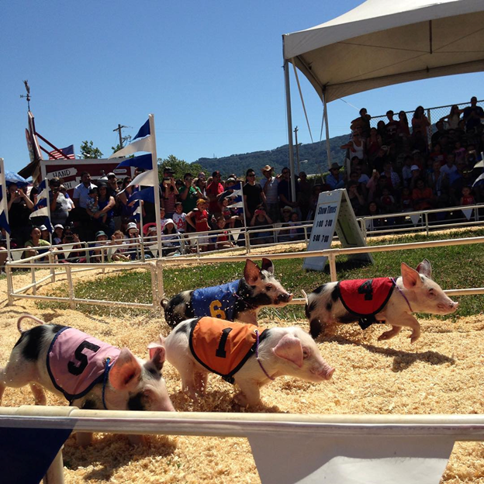
Introduction
Influenza is a highly varied RNA virus
3 HA and 2 NA types have caused human epidemics
Pigs are a known “mixing vessel” for avian and human strains
2011 fair with reports of respiratory illness in pigs and humans
Identified 3 people infected with H3N2v
Create a model to determine swine to human transmissibility
Apply model to total fair attendance estimates to determine total disease burden
Replicating model from :
Wong, K, et al. "Transmissibility of Variant Influenza From Swine to Humans: A Modeling Approach." Clinical Infectious Diseases 57.Suppl 1 (2013)

Slide 3
Research Question
Wong et al. Study question:
to estimate H3N2v transmissibility from swine to humans
Our research question:
Were methods used in Wong et al.’s study such as simulating the number of swine-acquired infections among all fair attendees and sensitivity analysis reproducible and are similar results obtained?

Slide 4
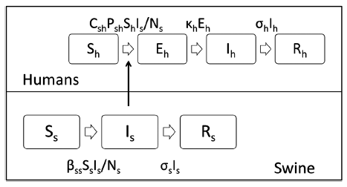
SEIR Human/SIR Swine Models

Slide 5
Methods
Model is based on a retrospective cohort of club member of an agricultural fair (Fair A)
Interviewed 100 club members with swine contact and obtained parameters.
Number of swine, number of infected humans and swine, mean duration of contact between humans and swine (not collected during interview), transmission rate from swine to human, swine to swine reproductive number, human incubation period, swine duration of infectiousness, human duration of infectiousness, pre-existing immunity to swine flu among both human age groups and duration of fair.
Investigators obtained parameters on age distribution and prevalence and duration of swine contact from Fair B.
Modeled H3N2v/H3N2pM transmission. Our ODES include two human age groups.
Ran a stochastic model to get best-fit transmission probability of H3N2v from swine to members of the agricultural club cohort
Run simulation of H3N2v Outbreak Among All Fair A Attendees With Swine Contact
Sensitivity analysis such that 75% of cases are estimated to be from H3N2v
Run another model with a higher duration of swine contact for the younger age group
dSc/dt = -cSH * betaSH * (Sc)* (Is/Ns)
dEc/dt = cSH * betaSH * (Sc) * (Is/Ns) - alpha * Ec
dIc/dt = alpha * Ec - gamma * Ic
dRc/dt = gamma * Ic
dSa/dt = -cSH * (Sa) * betaSH * (Is/Ns)
dEa/dt = cSH * (Sa) * betaSH * (Is/Ns) - alpha * Ea
dIa/dt = alpha * Ea - gamma * Ia
dRa/dt = gamma * Ia
dSs/dt = -betaSS * Ss * (Is/Ns)
dIs/dt = betaSS * Ss * (Is/Ns) - gamma * Is
dRs/dt = gamma * Is

Slide 6
Results
Our Simulation
81 people <20 years old that attended the fair became infected with swine flu.
58 people >= 20 years old was that attended the fair became infected with swine flu.
This indicates 1.25% of fair attendees aged <20 years old and 0.68% aged > or = 20 years old that had contact with swine became infected.
Wong et al. (2013)
80 people (95% CI: 40-133) <20 years old that attended the fair became infected with swine flu.
58 people (95% CI: 29-96) >=20 that attended the fair became infected with swine flu
This indicates 1.23% of fair attendees aged <20 years old and 0.68% aged >= 20 years old that had contact with swine became infected.
Overall, the results from our simulation are consistent with the results from the Wang et al. (2013) simulation and, although there are minor differences, our results only vary by 1 infection in the younger cohort, which falls within the range of potential values calculated in the 95% interval for the Wang et al (2013) simulation

Slide 7
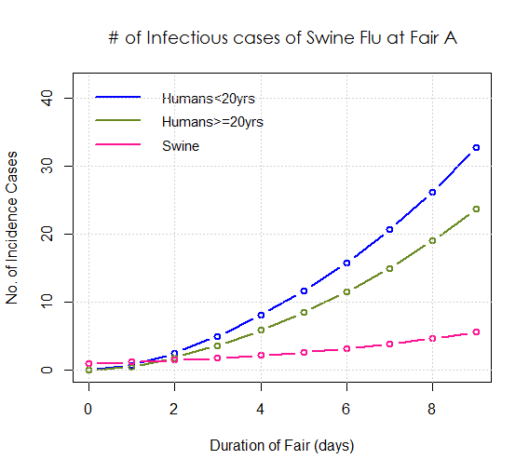
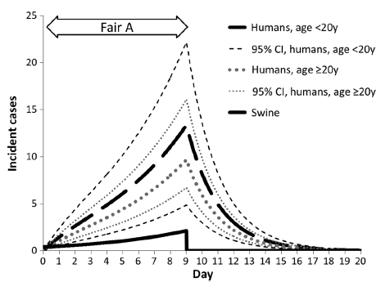
Results
Although our simulation produced the same number of cases in the older age group and varied by only one case in the younger age group there was a discrepancy between the graph for our simulation compared to the graph in the paper by Wong et al (2013).
Wong et al. (2013)
Our Simulation

Slide 8
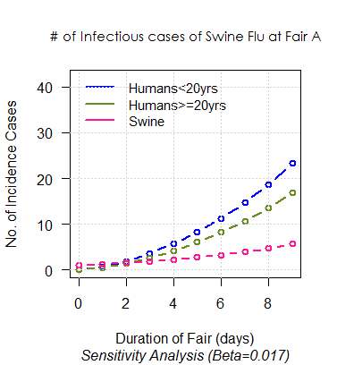
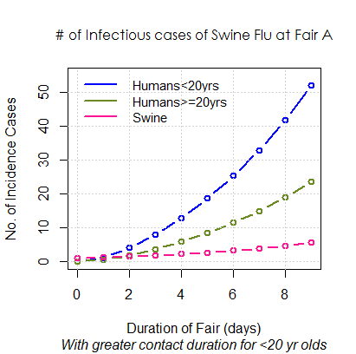
Results
Decrease in incidence observed when beta decreased from beta=0.024 to beta=0.017
Increase in incidence observed for both age groups when contact duration increased from 5 min to 8 min for those <20 yrs old

Slide 9
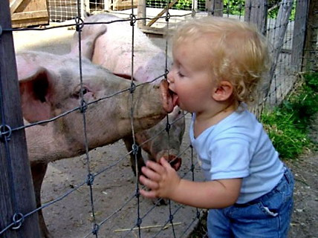
Discussion/Conclusion
Implications
Swine screening
Vaccinations
Reduce contact
Limitations
Values used (suspected vs. confirmed infections, sensitivity analysis proportion, reproduction number)
Characterization of swine contact
Future directions
More accurate measurements for future H3N2v outbreaks

Slide 10
Questions?

